Slide 1

Swag Labs E-Commerce Project
Final Graduation Presentation – DEPI

Slide 2


Introduction: Our Mission
1
2
Final Graduation Project
Core User Stories
Applying full STLC on Swag Labs.
Ensuring all primary user flows function correctly.
3
Defect Documentation
Thoroughly documenting all identified issues.

Slide 3
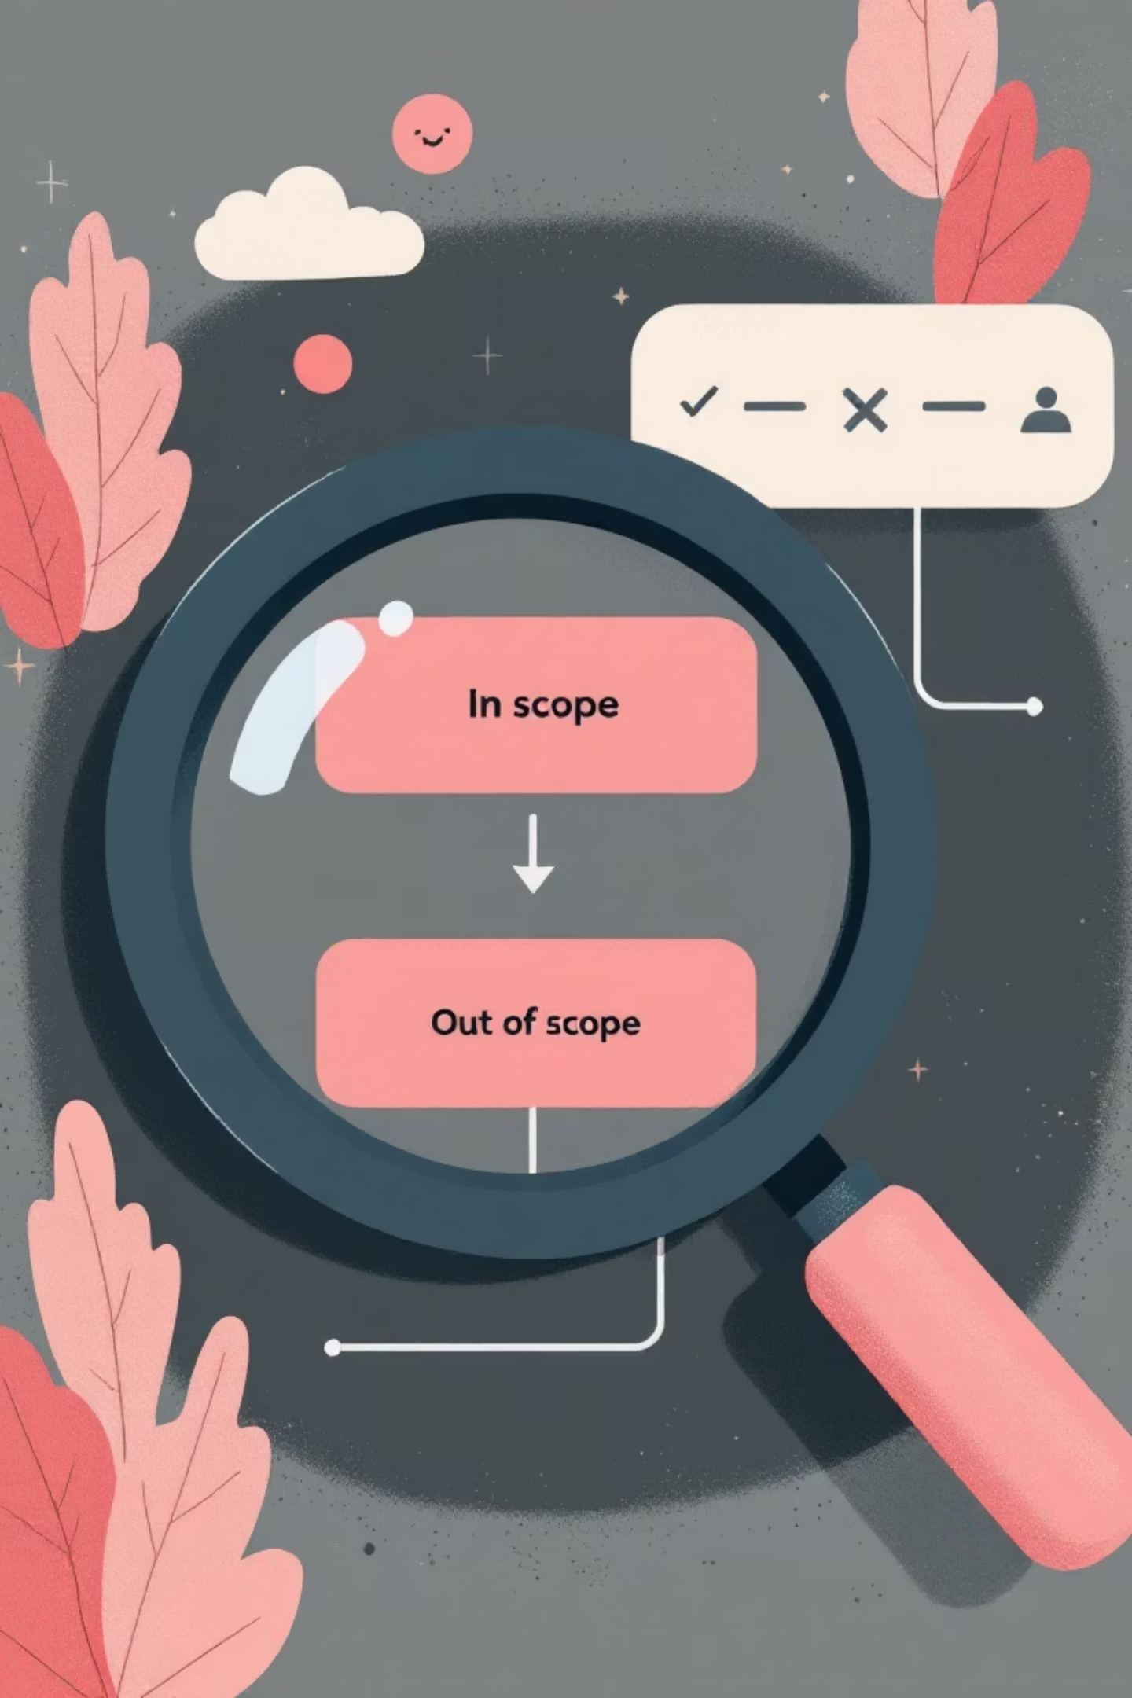
Project Scope: What We Covered
In Scope
Out of Scope
Functional Testing
Performance Testing
Manual Testing
Security Testing
UI Testing
Database Testing
Automation Testing
Compatibility Testing

Slide 4
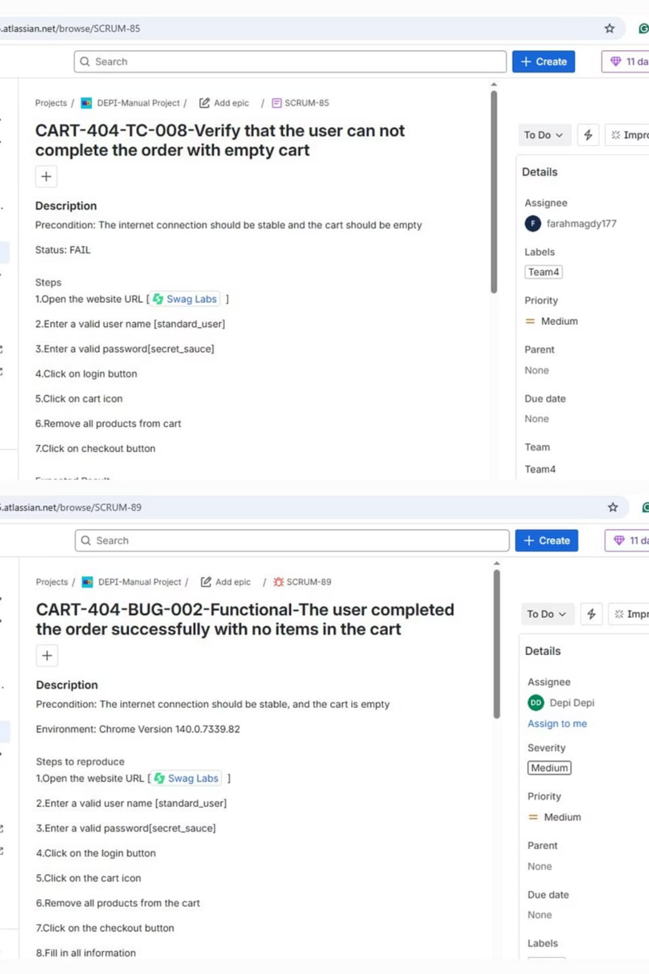
Manual Testing Insights
60
77%
23%
Total Test Cases
Passed
Failed
All executed.
46 successful cases.
14 cases, highlighting issues.
Key issues identified in input validation and edge cases across Chrome & Edge browsers.

Slide 5
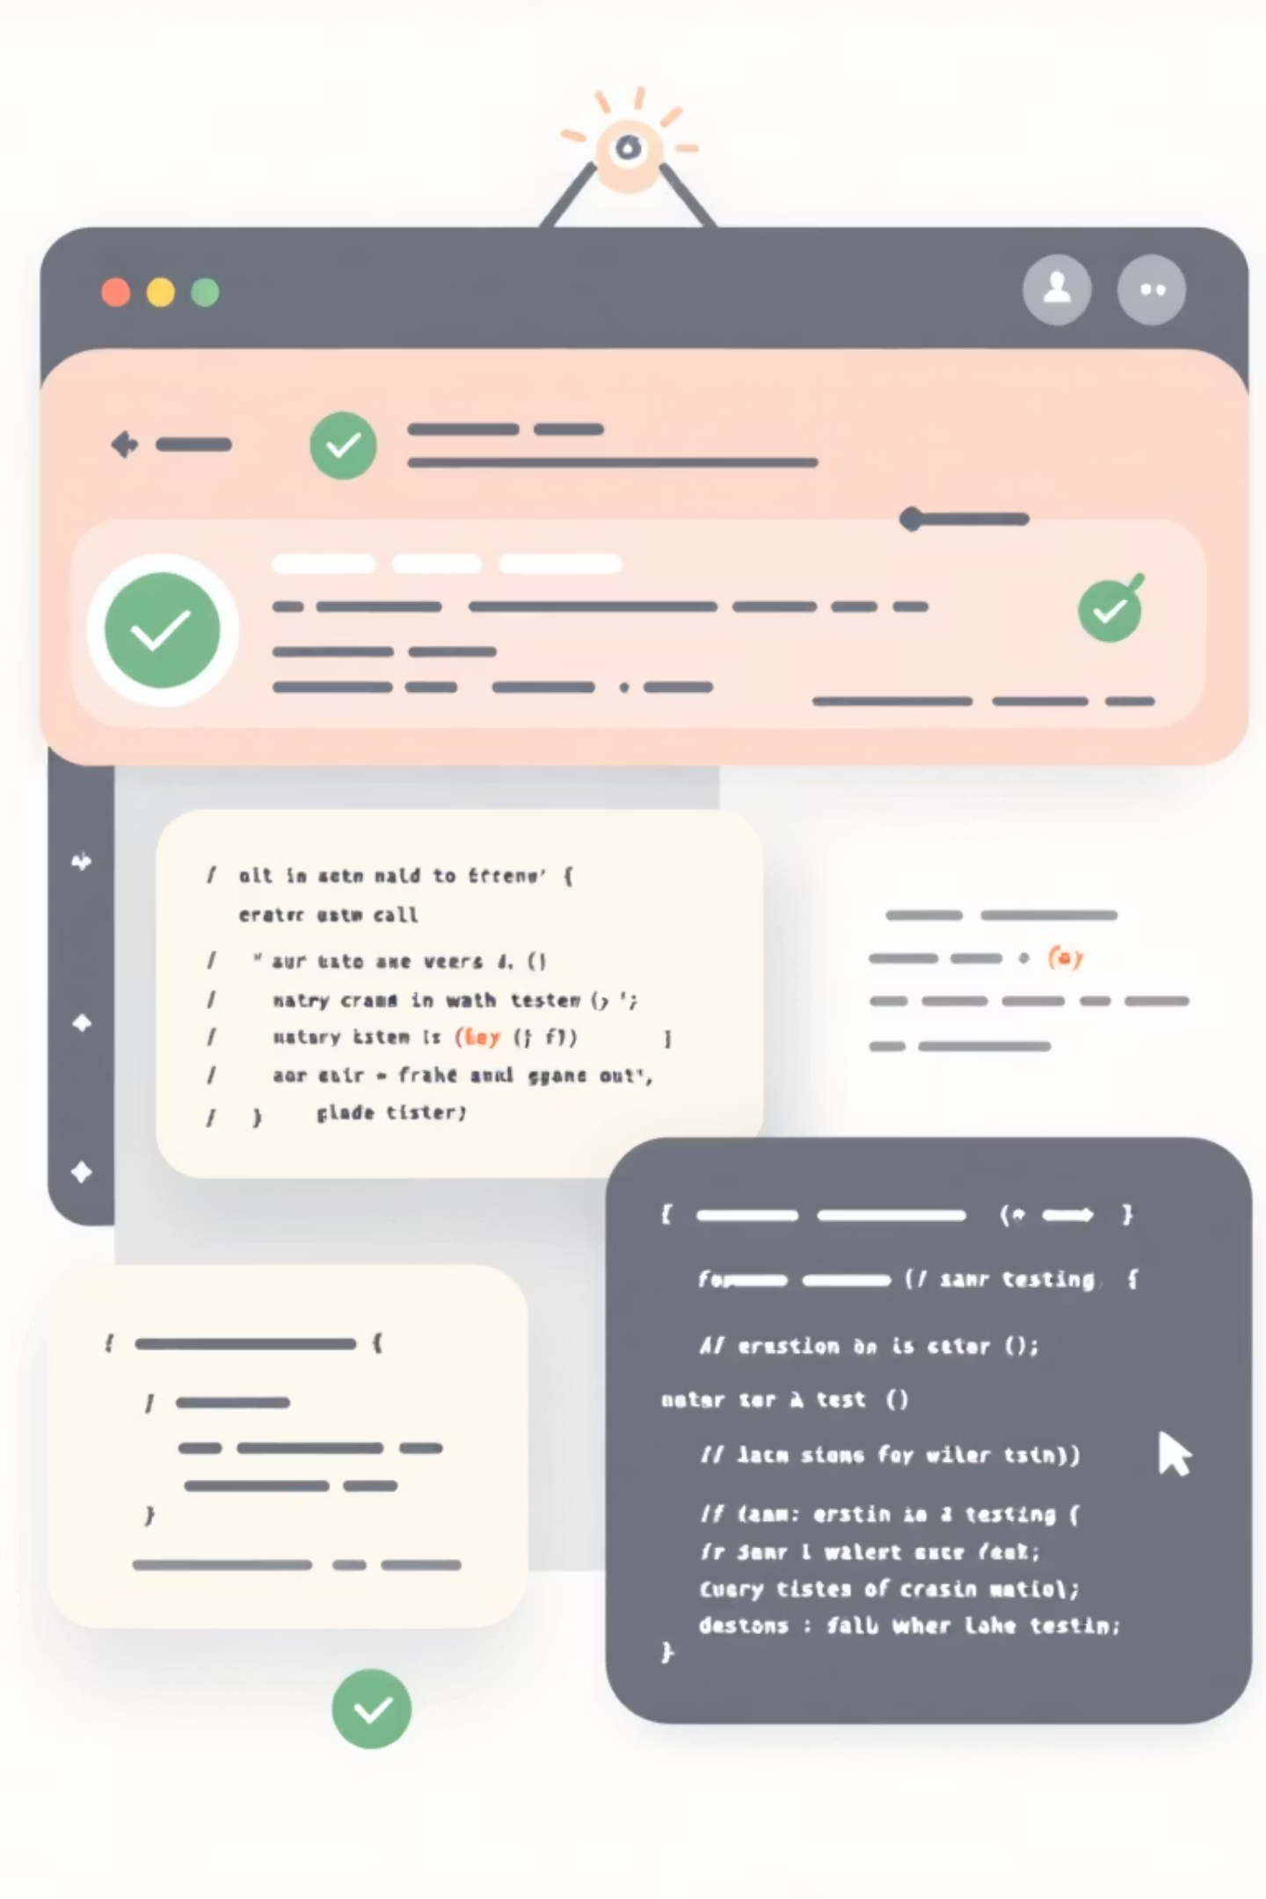

Automation Testing: Stability & Focus
Hybrid Framework
100% Pass Rate
Leveraging Selenium + TestNG.
23/23 scripts passed.
Standard User Flow
Focused on the 'Happy Path'.
Note: Edge cases found manually are currently not covered by automation.

Slide 6
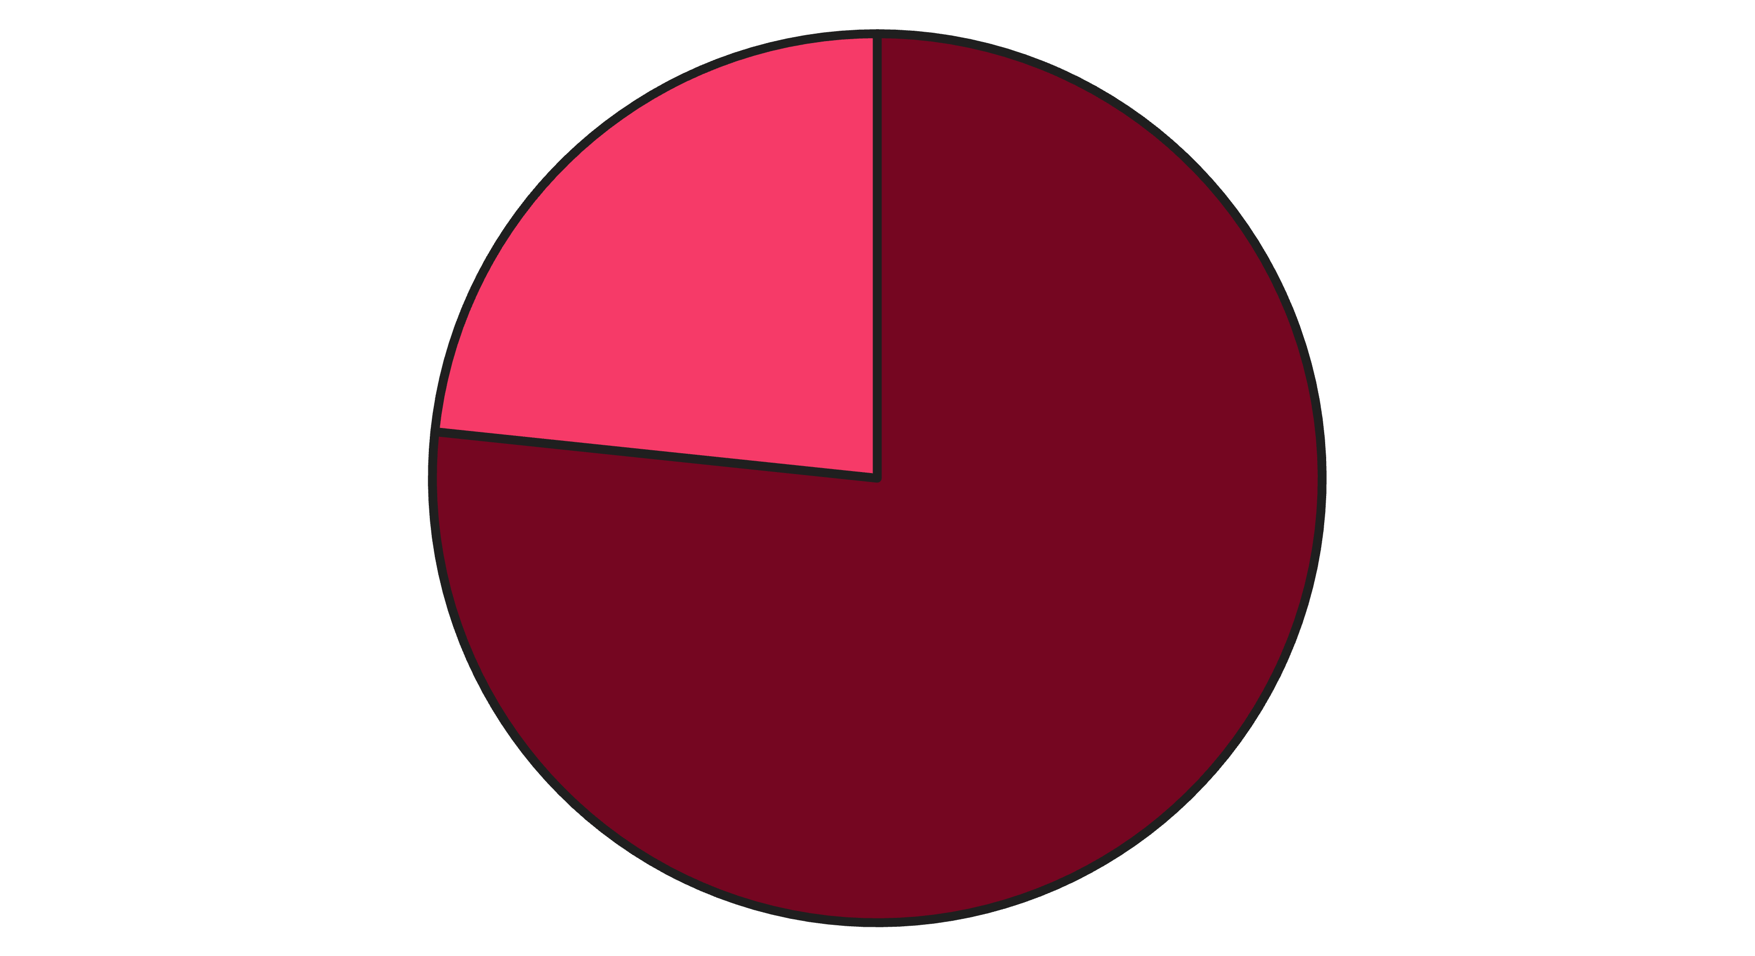
Key Findings: Overall Status
Passed
Failed
Major defects were found manually, indicating critical issues that could block production. Automation is stable for main flows.

Slide 7
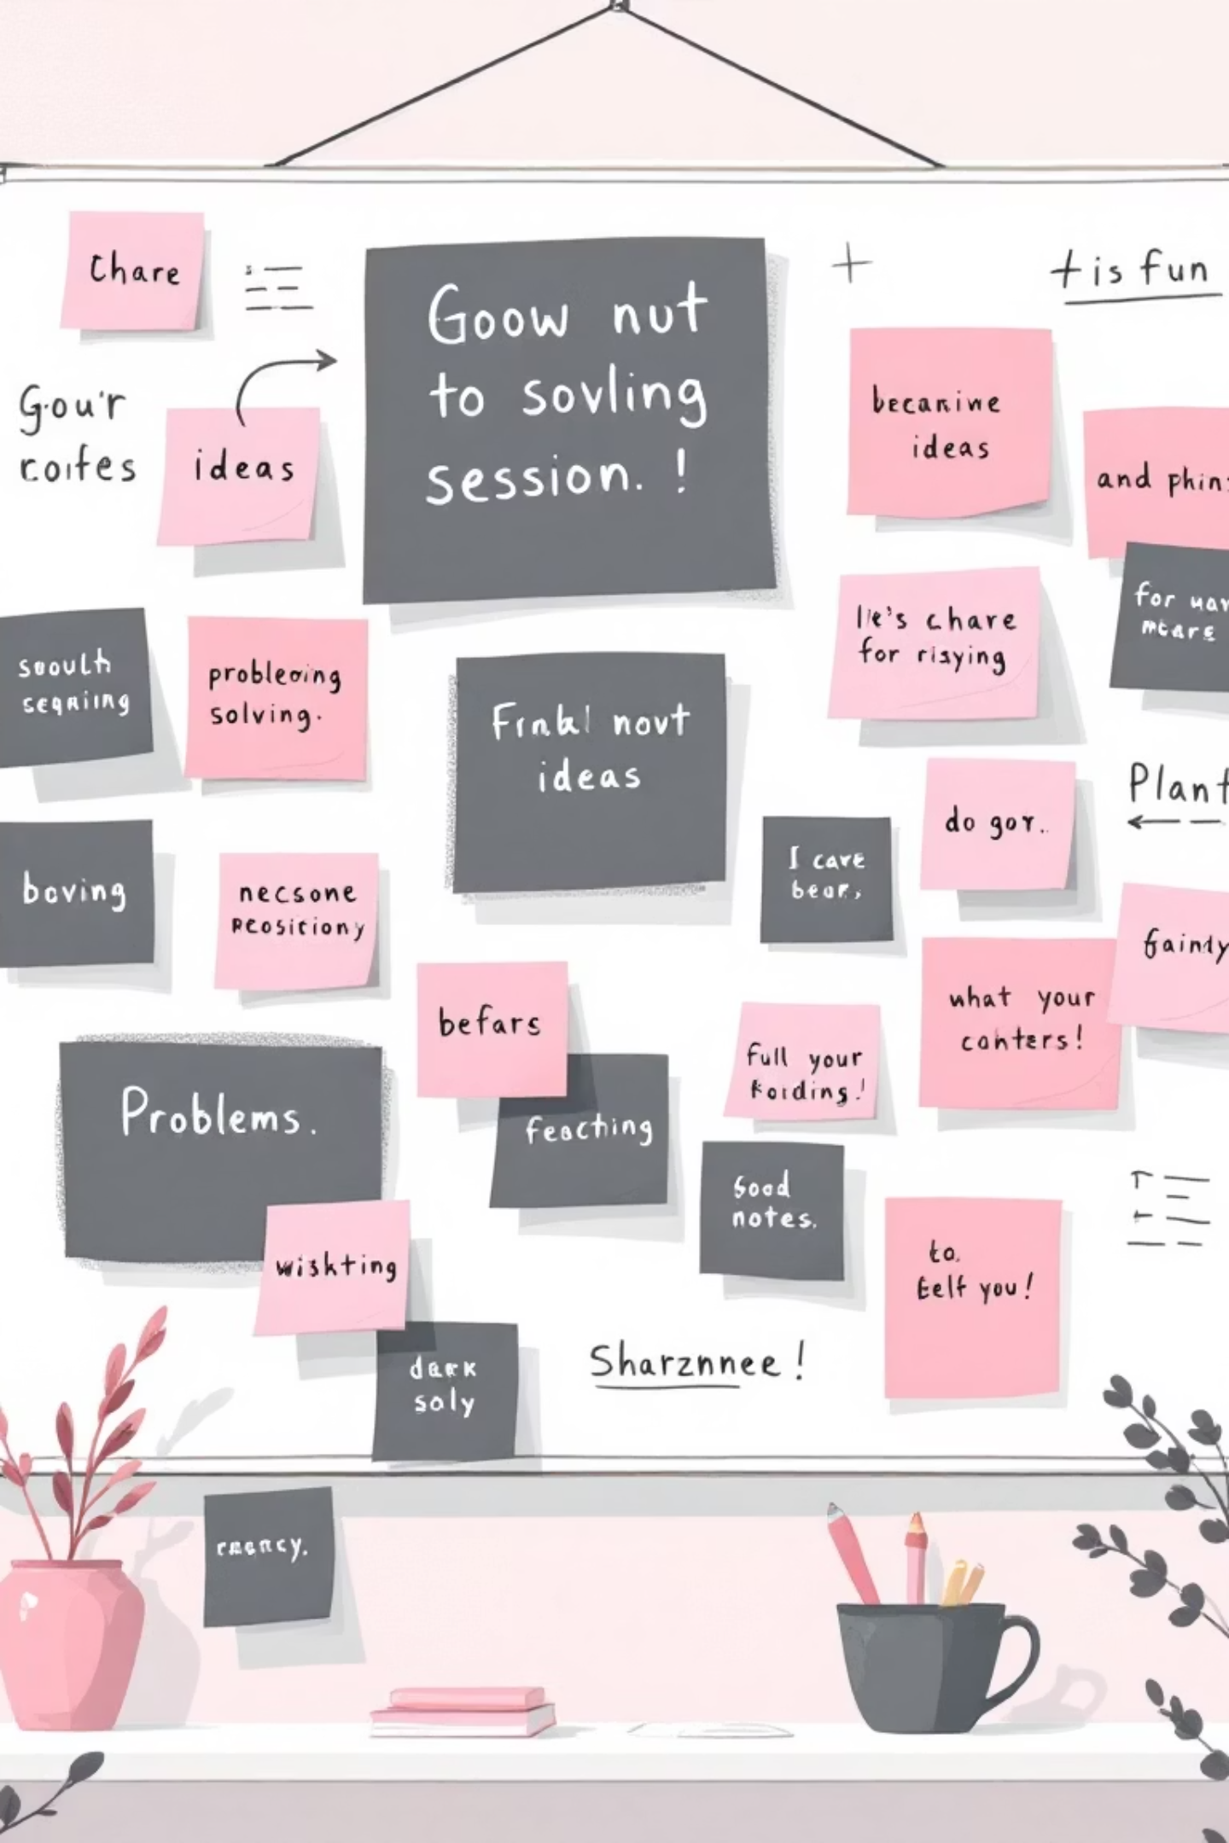


Challenges & Lessons Learned
Challenges
Inconsistent validation
Complex edge cases
Environment setup issues
Lessons
Manual + automation complement
Thorough documentation
Early edge case identification

Slide 8

Thank You
Prepared by:
Farah Magdy
Esraa Sameh
Aml Ahmed
Ahmed Akram

